Slide 1
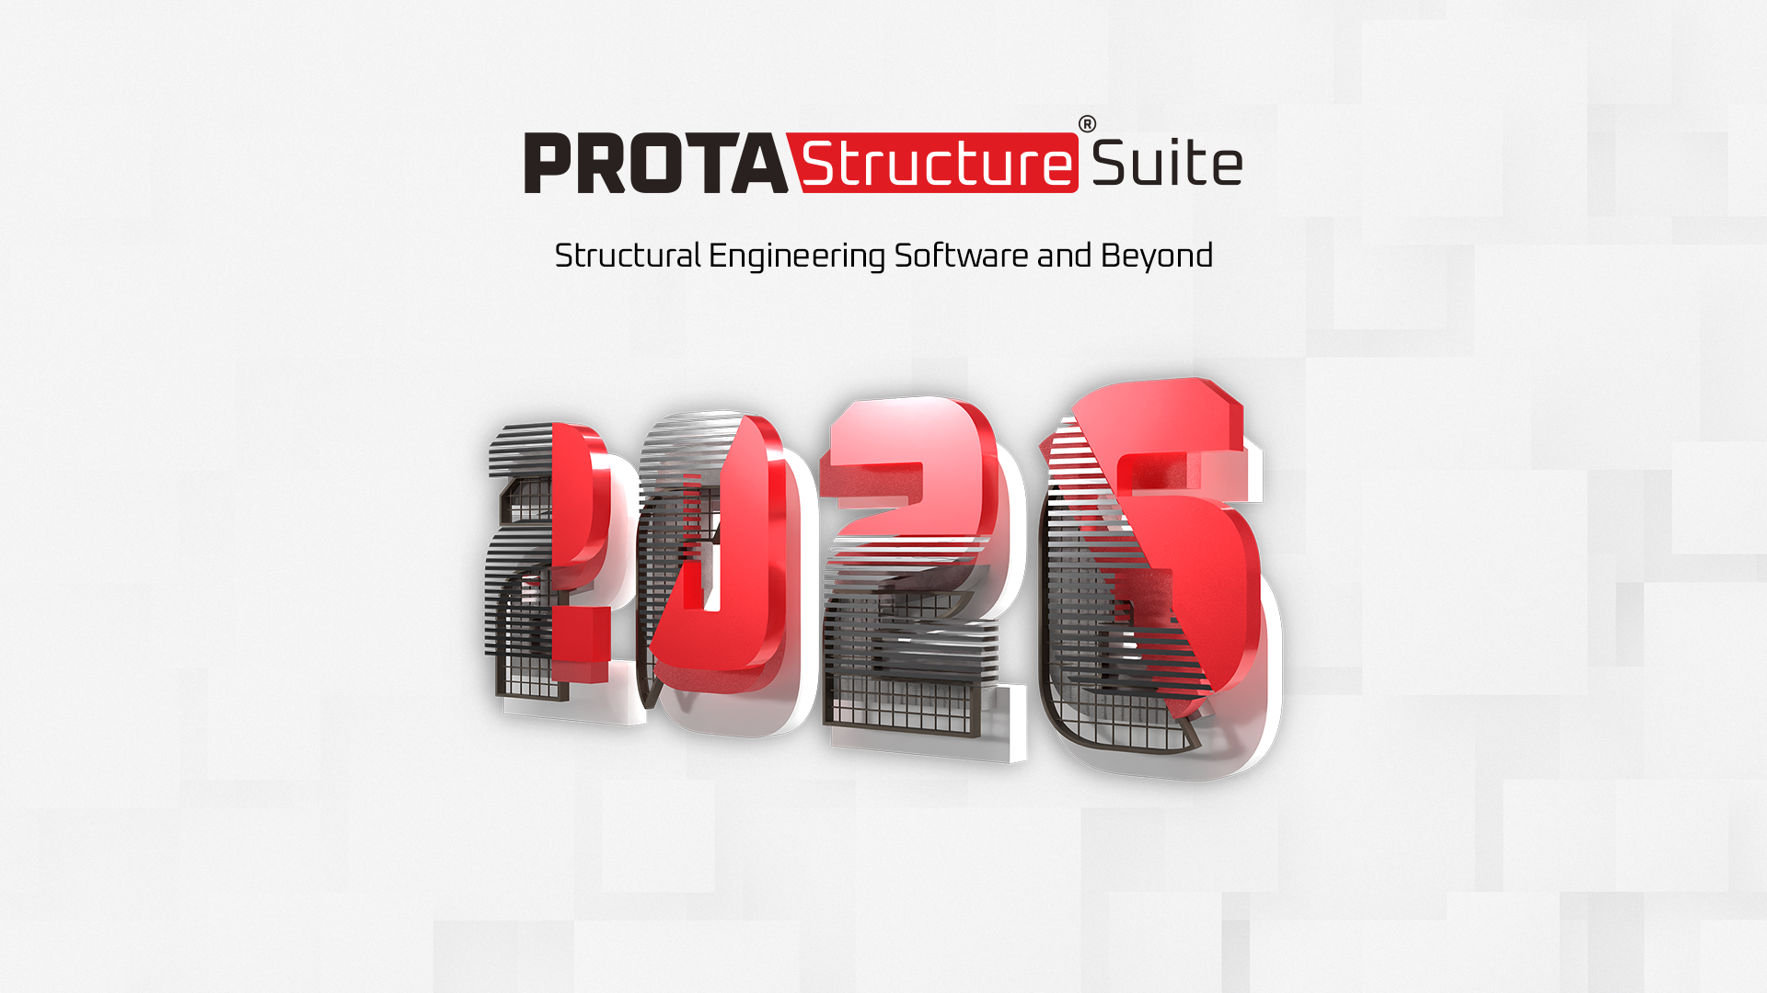

Notes:
Hello everyone, this is … from the business development team at Prota Software. I would like to thank … for starting the webinar and introducing their team. We are very excited to have … as our partner and look forward to great days ahead! Also, I am aware that we have … attending, I welcome you all as well as all of our other attendees. Thank you for joining us today.

Slide 2
1
Prota Software & Products Overview
2
What Do We Offer?
3
Core Advantages
4
Project Referances
5
ProtaStructure Suite Live Demo
Notes:
Alright! Here is our agenda for today. I will quickly talk about the journey of Prota, provide a very brief background about us, what we offer and the core advantages of our software technologies and references.
I will then hand over to Volkan for the detailed demonstration of our solutions.

Slide 3

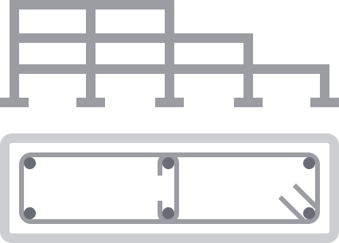
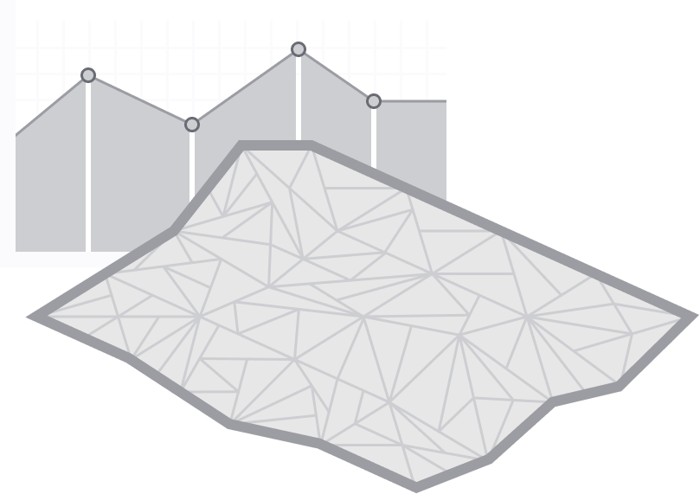

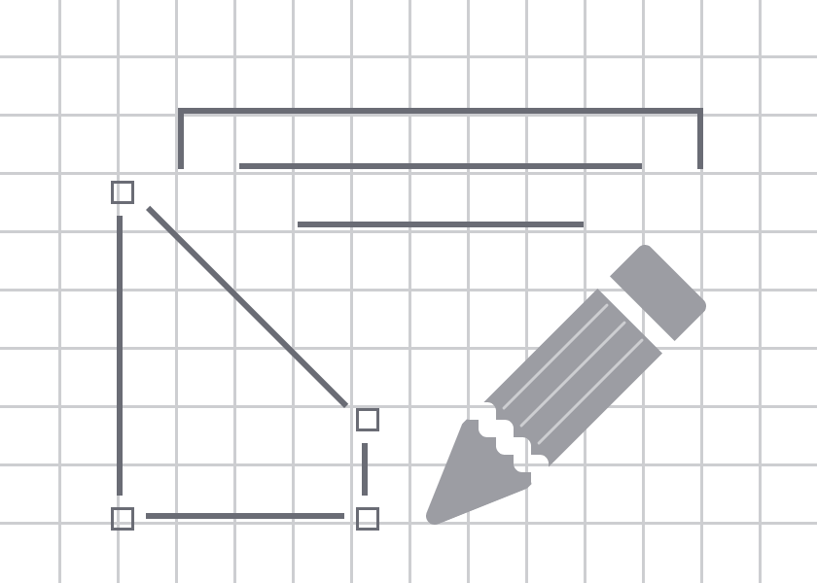
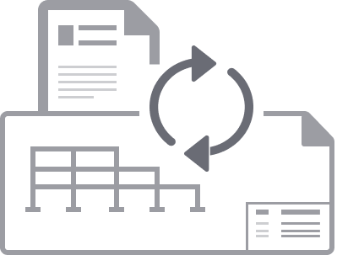
ANALYSIS
MODELING
DESIGN
FABRICATION
DETAILING
BIM
Notes:
ProtaStructure is a unique platform for building design and the sole offering that we provide for customers worldwide.
You might ask, what makes ProtaStructure unique? We differentiate ourselves by integrating Modeling – Analysis – Design – Detailing – Fabrication and BIM processes, seamlessly allowing you to integrate the whole process in a single solution. This allows our users to rapidly deliver their projects using a single software. Hence, the reason we refer to ProtaStructure as an All-In-One software!

Slide 4





Multi-Material Modeling, FE Analysis and Design
Automated and Interactive RC Detail Drawings
BIM Collaboration Tools
Steel Connection Design, Detailing and Fabrication
Notes:
ProtaStructure Suite consists of 4 different modules and can be provided as a single package.
We have ProtaStructure which is the core system for modelling, analysis and design of your structures.
It is complemented with other tools - ProtaDetails a complete CAD system for automated detailing and drawings. It focuses on concrete detailing and includes a unique design library of calculations for designing things like retaining walls and piles.
ProtaSteel complements steel design by automating all the steelwork connection design, providing comprehensive steel detailing and automated connection design of your structures. Important to note, we provide drawings and calculation reports within ProtaSteel as well.
And finally, ProtaBIM allows you to connect with other tools and systems that you may be using allowing you to collaborate better with team members. ProtaBIM allows you to communicate with other BIM platforms and software solutions like ALLPlan through IFCs or Arkiked through SAF. Or even share an analytical data with SAP and ETABS.

Slide 5

40
10
250
+ Years of Experience
Language Support
Design Guides and Manuals
100
24
25
+ Countries
Partners
International Design
Codes
Notes:
For more than 40 years, we have been expanding our reach around the world covering 25 international design codes, 10 languages such as Polish, Spanish, Portuguese, Thai and English.
We have also been busy creating design guides and insights into how the software. For example, many of our users benefit from technical guides that cover guidance to punching shear checks, foundation design, seismic design, retrofitting and many other topics.
At this point, we have licensed users in over 100 countries around the world.

Slide 6
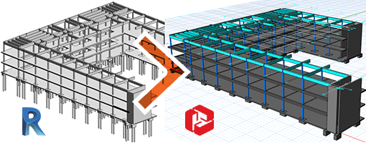
Our History
1992
Probina Orion is launched as the world’s first concrete building design and detailing system
Probina Orion provides
the first building solution for
Retrofit and Rehabilitation
2005
2007
Bi-direction physical model integration with Autodesk Revit
Notes:
Here, I want to briefly summarize some of the milestones of Prota Software’s journey throughout the years.
Some of you might actually know us from back in 1992 as Prota launched Probina Orion which is the worlds first concrete building design and detailing system.
In 2005, Probina Orion had provided the first ever building solution for Retrofit and Rehabilitation.
In 2007, Prota invested in BIM technology and launched ProtaBIM which, as mentioned before, provides Bi-directional physical model integration.

Slide 7
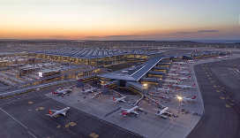

Our History
2014
ProtaStructure is introduced
2018
Prota delivers the world largest airport terminal building
2026
Prota Software achieves licensed users in 100 different countries
Notes:
In 2014, Prota Software introduced our unique ProtaStructure Suite.
In 2018, the Prota team delivered the world’s largest passenger terminal building. The Structural design of this project was delivered with ProtaStructure Suite. If you would like to read more on this, feel free to visit our webpage, and check out some of the success stories we’ve published.
In 2026, we stand having spread the software in 100 countries and continue to grow our userbase.

Slide 8



An Expanding Global Company
Poland
Latvia
France
Serbia
Romania
Macedonia
Spain
Turkey
Greece
Cyprus
Iraq
Florida
Libya
India
Hong Kong
Dominican Republic
Thailand
Nigeria
Philippines
Colombia
Malaysia
Ghana
Kenya
Singapore
Rwanda
Brazil
Tanzania
Indonesia
Zambia
South Africa
Notes:
Through this map, you can see an overview of our footprint as Prota Software. We are present all the way from South America, to Africa, up into Europe down to India and Southeast Asia. Our partners are represented by the yellow dots and the hexagons represent direct presence in those nations. We are determined to continue increasing our partner network along with our user base; only a matter of time until we cover most of the countries all around the world.

Slide 9



Modelling & Analysis
Staad, Sap, Midas, S-frame, Robot, Etabs, Space Gass, …
Modelling & Analysis
A software for streamlined building modelling and analysis
Design
Many of these do some design – element design
Design
A software for designing your steel connections,
concrete beams, core walls, foundations and more
Component design
Tedds, Scale, Prokon, LIM con, …
Detailing / Drafting /Component design
A CAD software for dedicated structural drafting and producing all your engineering drawings, with component design for other project elements (like retaining walls)
Detailing/Drafting
AutoCAD, BrisCAD, GStar CAD, there’s so many…
Fabrication
Tekla Structures, Advanced Steel, BOCAD, …
Fabrication
A Fabrication software for producing all your
construction and shop details
Structural BIM
Revit, Tekla Structures, BOCAD, Archicad, …
Structural BIM
A BIM software for communicating all of this to other project team members, Owners, Architects, M&E specialists etc.for coordination
Notes:
As you know there are several software solutions that offer various services.
Our core advantage is that ProtaStructure Suite offers these important features in a single suite.
So we can confidently say that ProtaStructure is a;
A software for streamline modelling and analysis.
a software for designing your steel connections, concrete beams, core walls, foundations and more.
a CAD software for dedicated structural drafting and producing all your engineering drawings, with component design for other project elements like retaining walls.
a Fabrication software for producing all your construction and shop details
a BIM software for communicating all of this to other project team members.

Slide 10
Multi-Material Modeling, FE Analysis and Design
Main Capabilities:
Flexible 2D and 3D True Structural BIM Modelling
Multi-material Modelling with Physical Objects,
Analysis and Detailed Design to International Seismic and Design Codes
Seismic Assessment, Retrofitting and Seismic Isolators
Full design reporting and quantity takeoff
Links with ProtaDetails for Automated Drawings
SAF Integration and IFC Import/Export
Notes:
ProtaStructure is an extensive structural engineering software with a lot of know-how and details embedded in every step of the way.
ProtaStructure forms the core of our Suites. It is a BIM design solution for concrete and steel buildings. Some of the capabilities offered are, flexible 2D and 3D Modelling, Multi-material Modelling with Physical Objects, Analysis and Detailed Design to International Seismic and Design Codes, Full design reporting and quantity take-off and so on. With ProtaStructure, your business will benefit from rapid modeling on an easy-to-use platform while effortlessly creating your intelligent drawings and full design documentation with the availability of a wide range of international design and seismic codes.

Slide 11
Automated and Interactive RC Detail Drawings
Main Capabilities:
Structural details rapidly with intelligent objects/templates
Full / Partial quantity take off
Links with ProtaStructure for automated drawings
Manage and update details when model and design changes occur
Component design library with detailing
Sheet management using multiple files and title blocks
Powerful CAD Engine
Notes:
Working with ProtaStructure, ProtaDetails is a revolutionary system for automatically creating and organizing all your structural concrete detail drawings rapidly.
You can save hours of drafting time by seamlessly extracting design details from ProtaStructure and automatically arranging them onto your company drawing sheets.
We continuously expand our library of component macros in ProtaDetails, which in return save time and cost to our clients’ businesses.

Slide 12
Steel Connection Design, Detailing and Fabrication
Main Capabilities:
Perform automated steel connection design
Take models designed in ProtaStructure directly into ProtaSteel
Visualize and coordinate models in 3D, add ancillary steelwork, and fully quantify your projects
Reduce design and detailing time by automatically producing high quality engineering drawings
Coordinate your projects with other leading BIM platforms including Autodesk Revit and TeklaStructures
Notes:
ProtaSteel is our all-in-one steel detailing solution that allows structural engineers and detailers to perform automated steel connection design and produce high-quality steel detail drawings in a few minutes.
You can take models designed in ProtaStructure directly into ProtaSteel and save hours with the automated design of a comprehensive range of bolted and welded steel connections of your choice.

Slide 13
BIM Collaboration Tools
Main Capabilities:
Communicate and coordinate models with other project stakeholders
Ful interoperability with BIM platforms such as Autodesk Revit
Intelligent model auditing tools to track and review changes
Quickly and efficiently coordinate your projects before construction starts and save hours of wasted time
IFC and SAF Import and Export
2D and 3D DXF Import and Export
Export Analysis Data
Notes:
Finally, ProtaBIM allows you to connect with other tools and systems to collaborate better with team members. ProtaBIM allows you to quickly and efficiently coordinate your projects and save hours of wasted time. You can communicate with other BIM platforms and software solutions like ALLPlan through IFCs or Arkiked through SAF. Or even share an analytical data with SAP and ETABS.

Slide 14




Steel Connections and Detail Drawings for Fabrication
– DXF and CNC Data
- IdeaStatica Export
Automated & Interactive RC Detail Drawings
– DWG and DXF
Focused Solution for modeling,
FE Analysis and Code-based Design
Design Reports, Data and Images
– Office, 2D&3D PDF, Print
Analysis Data Communication
– OpenSees & Other Analysis
Software Results to Excel CSV
Bi-directional IFC and SAF Links
2D and 3D DXF
Bi-directional Bespoke BIM Link
with Revit
Notes:
ProtaStructure Suite is developed with BIM in mind. Here on this slide, you can see the entire BIM flow of our software solutions. Remember that all these solutions are offered in a single economical suite called ProtaStructure Enterprise.
1) You can use ProtaDetails, the revolutionary structural drawing and detailing software for automatically creating and organizing all your RC detail drawings only with a single click.
2) You can then take models designed in ProtaStructure directly into ProtaSteel and save hours with automated design of a comprehensive range of bolted and welded steel connections of your choice.
3) You can bi-directionally link your models to other BIM platforms and software solutions like Autodesk Revit, ALLPlan and Arkiked with latest data formats including IFC, 2D/3D DXF and SAF.
4) You can transfer and compare your analytical model with other general purpose analysis software such as ETABS, SAP 2000.
5) You can also create and share highly visual calculation reports featuring Microsoft Office and PDF export abilities.

Slide 15
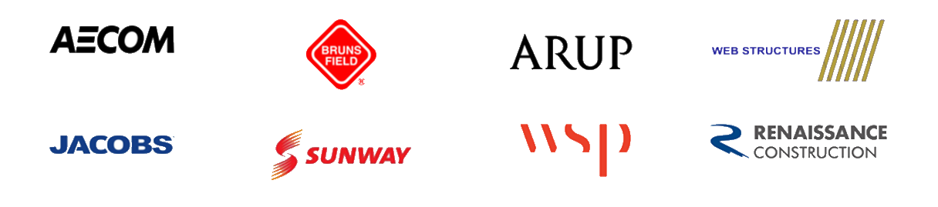
Product Excellence
ProtaStructure is used by thousands of leading engineering consultants around the world to design and deliver their projects quickly and efficiently.
Trusted by thousands of great businesses around the world
Notes:
Product excellence is a necessity in our sector! And it is also the key to our success.
ProtaStructure is being used by thousands of large enterprises all around the world.
If you may have heard them, some worth mentioning are AECOM, Sunway, ARUP, WSP and Jacobs. These organisations have been using our products to deliver their engineering projects.

Slide 16
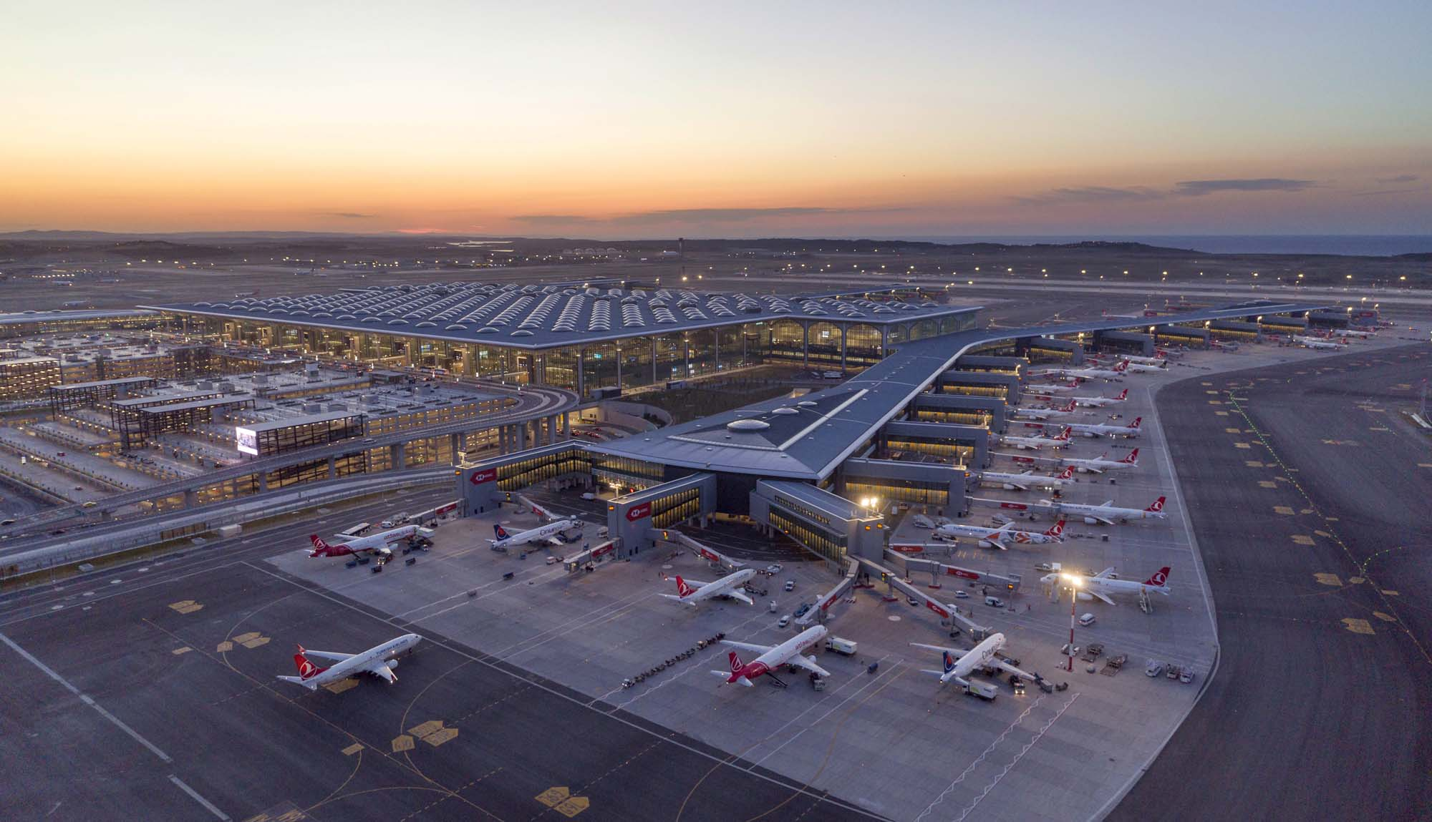
Biggest Passenger Terminal Building of the World
«
ProtaStructure played a crucial role in delivering the structural design of the world’s biggest airport terminal building.
“We used ProtaStructure throughout the entire life cycle of the project where we were able to manage project variations quickly, economically, and accurately.
Umit Kacmaz General Manager – Prota Engineering
»
Istanbul New Airport
1,500,000 m²
Notes:
As I have mentioned earlier, ProtaStructure was used in modeling and designing of the biggest Passenger Terminal Building of the World located in Istanbul covering 1.5 million square meters. And General Manager Mr. Umit has made a statement attributing the added success to ProtaStructure’s ability to perform project variations quickly, economically and accurately.

Slide 17
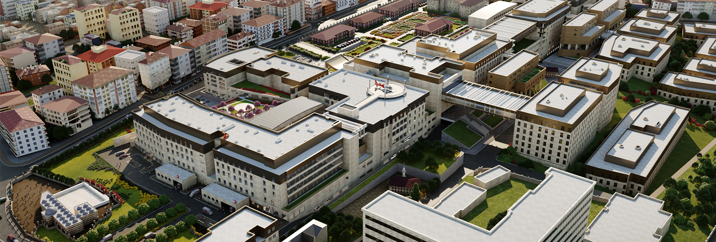
Largest University Campus in İstanbul
Structural design was performed by ProtaStructure
Cerrahpasa Healthcare and Education Buildings
1,000,000 m²
Notes:
If I may continue with a few other real life project examples completed using ProtaStructure, this is the largest university campus project in Istanbul, that was also delivered with ProtaStructure Suite.
There were over 50 buildings within the campus project covering 1 million square meters of construction area.

Slide 18

Productivity: Don’t Just Take Our Word For It
«
With ProtaStructure our productivity has increased 300% over traditional approaches – we have taken on more work and are far more profitable and competitive with ProtaStructure
Kwang Eng Yau
Executive Director – Kemasepakat (Malaysia)
»
Istana Negara Malaysia (Kings Palace)
Kuala Lumpur, Malaysia
Notes:
The Kings Palace, situated in Kuala Lumpur, Malaysia, stands as the government's most significant investment. The project was delivered by Kemasepakat, one of our esteemed clients in Asia. As per the Executive Director, ProtaStructure has revolutionized their productivity, leading to a remarkable 300% increase compared to traditional methods. Thanks to ProtaStructure, they have expanded their workload and become more financially profitable and competitive.

Slide 19
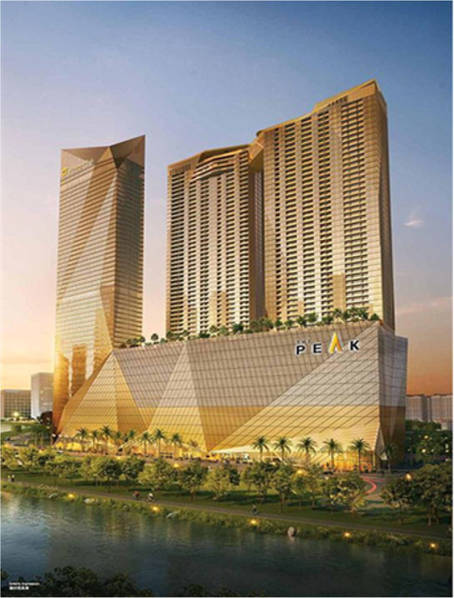
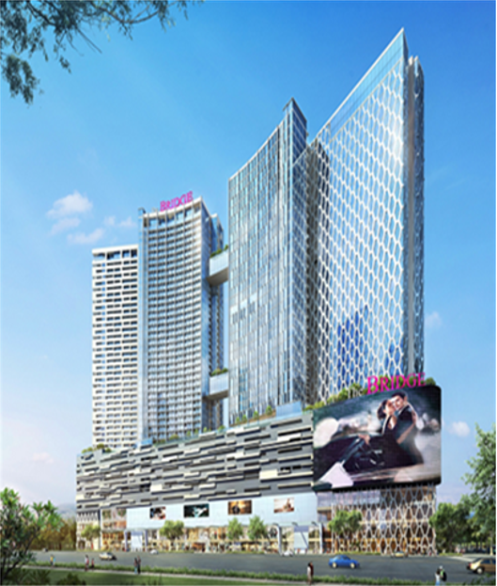
Project Delivery Across Asia
Mixed shopping and commercial development design by TWT Design Consultants
The Peak
Cambodia
Oxley Development
Cambodia
Notes:
Again, our client TWT Design Consultants have delivered very prestigious structures using ProtaStructure Suite across Asia.

Slide 20
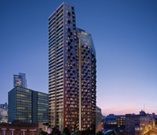
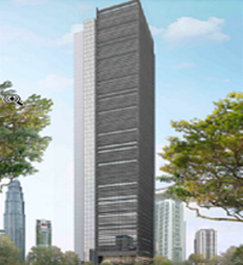
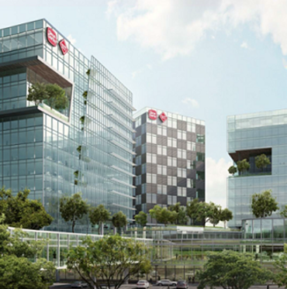
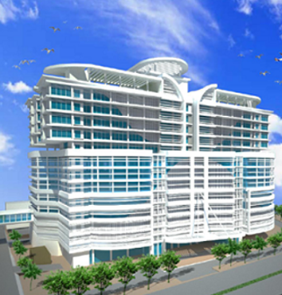
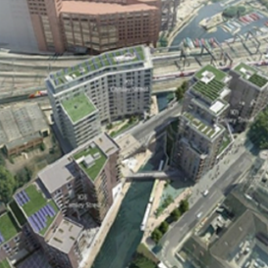
Project Delivery Across Asia, Europe
The Stage, London
Maverick Consulting Engineers
Wide range of commercial and residential projects using ProtaStructure
The Stoner, Kuala Lumpur
Oasis Tower, Malaysia
Ipoh Hospital, Malaysia
Camel Street, London
Notes:
There are also some prestigious projects delivered with ProtaStructure Suite from our clients across Southeast Asia and Europe such as The Stage Building and Camel Street in London.
As well as the stoner, Ipoh hospital and Oasis tower in Kuala Lumpur.

Slide 21
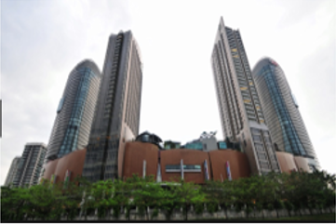
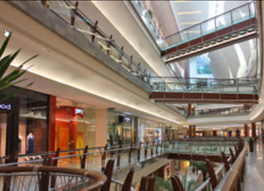
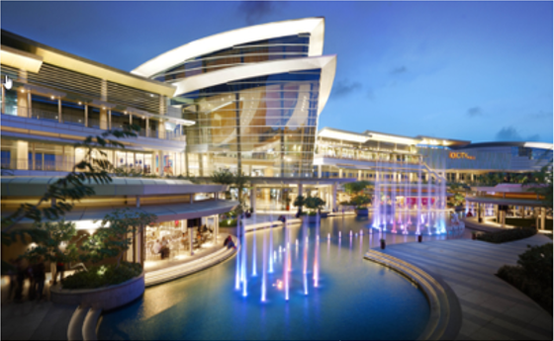
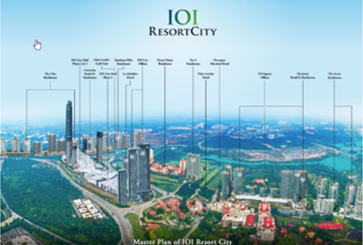
Project Delivery Across Asia, Europe
Garden Mall
Kuala Lumpur, Malaysia
Delivered by EDP Consulting Group. Garden mall is part of Mid Valley City, Kuala Lumpur’s largest shopping mall
and entertainment complex
I0I Mall, Malaysia
I0I Resort City, Malaysia
IOI Resort World
Putrajaya, Malaysia
Also delivered by EDP Consulting Group. Currently Malaysia’s largest mixed development Project under constrution
Notes:
A few other examples from Kuala Lumpur and Putrajaya in Malaysia. You can see Garden Mall, Resort City project that was delivered in Malaysia with ProtaStructure Suite…

Slide 22
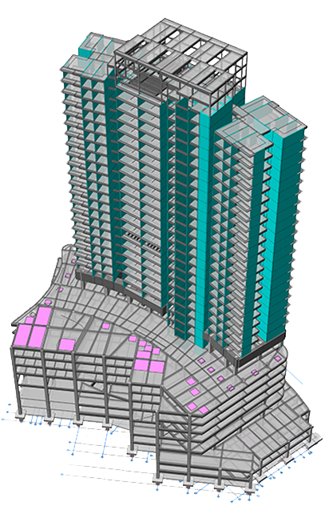
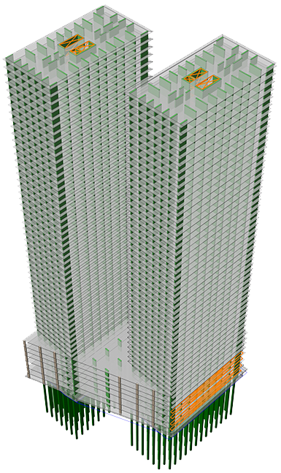
Project Delivery Across Asia, Europe
Nik Jai Associates Sdn Bhd
35–Storey, Malaysia
Notes:
A Shopping mall in Singapore is among other projects delivered with ProtaStructure Suite.

Slide 23
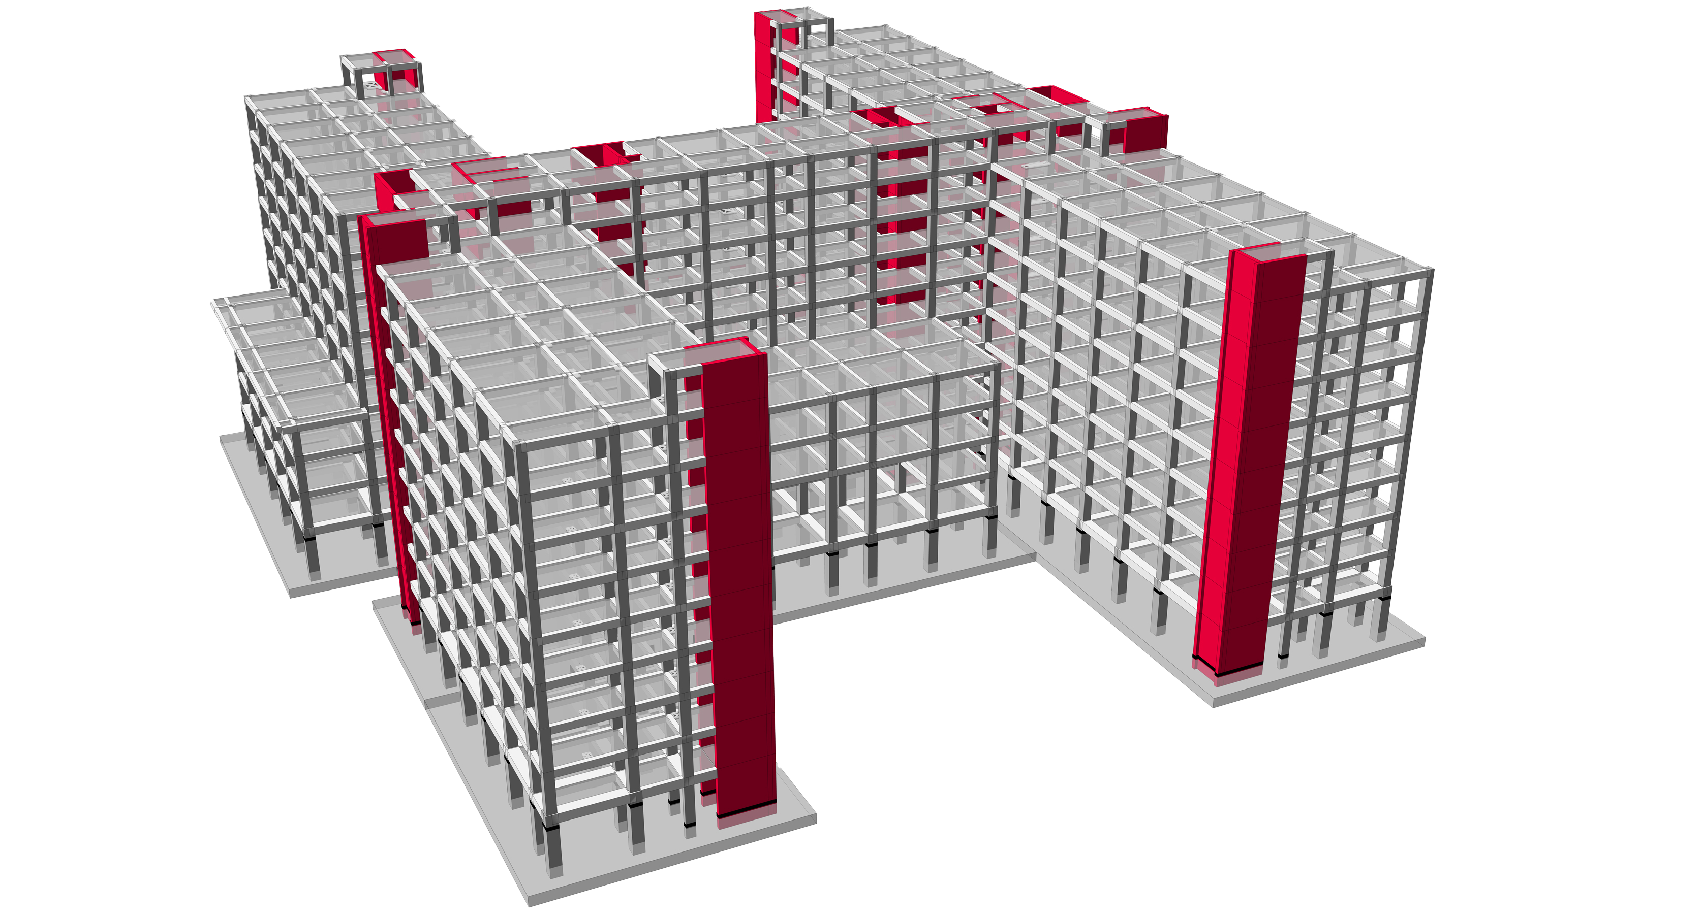
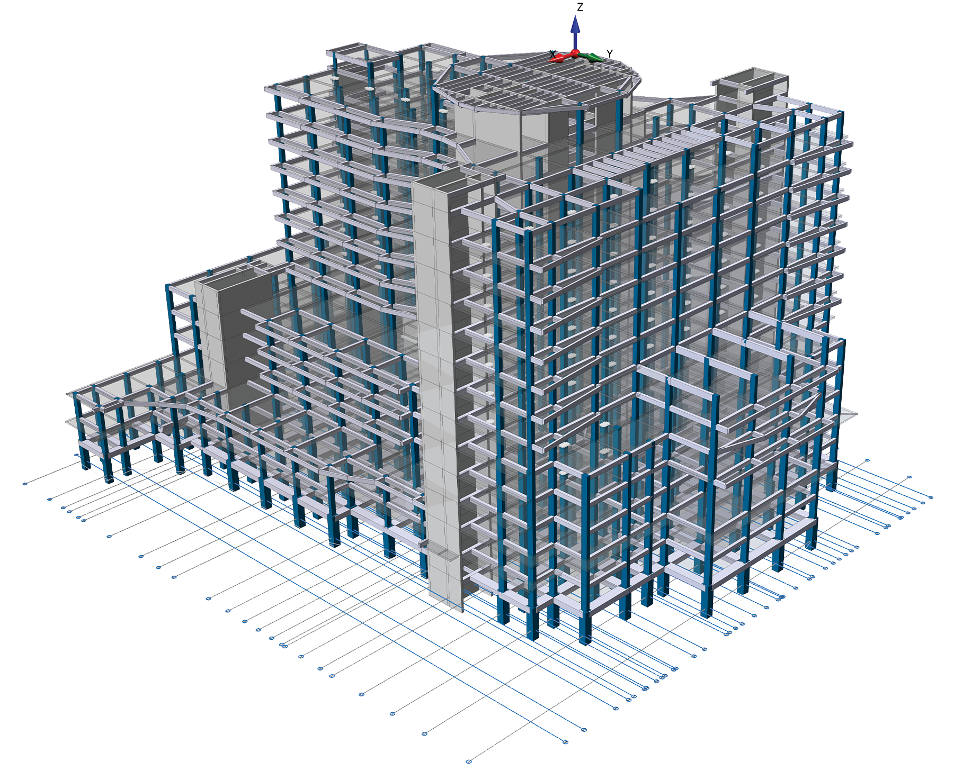
Seismically Isolated Hospitals Across Europe, Middle East
Notes:
Several hospitals were also designed with ProtaStructure Suite. One worthy note is that these hospitals are also seismically retrofitted buildings.
With ProtaStructure’s unique seismic capabilities, you can insert seismic isolators into your buildings too.

Slide 24
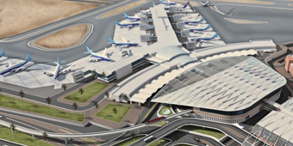
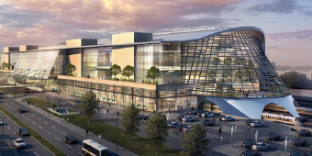
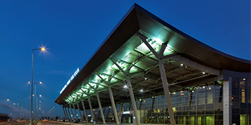
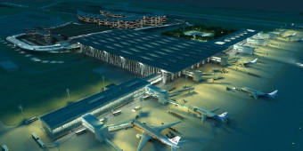
International Airports
Cairo Airport, Egypt
Ankara Train Station, Turkey
Prishtina Airport, Kosovo
St. Petersburg Pulkovo Airport, Russia
Notes:
Important international airports and train terminals across Russia, Kosovo, Egypt and Turkey were delivered with ProtaStructure Suite.

Slide 25
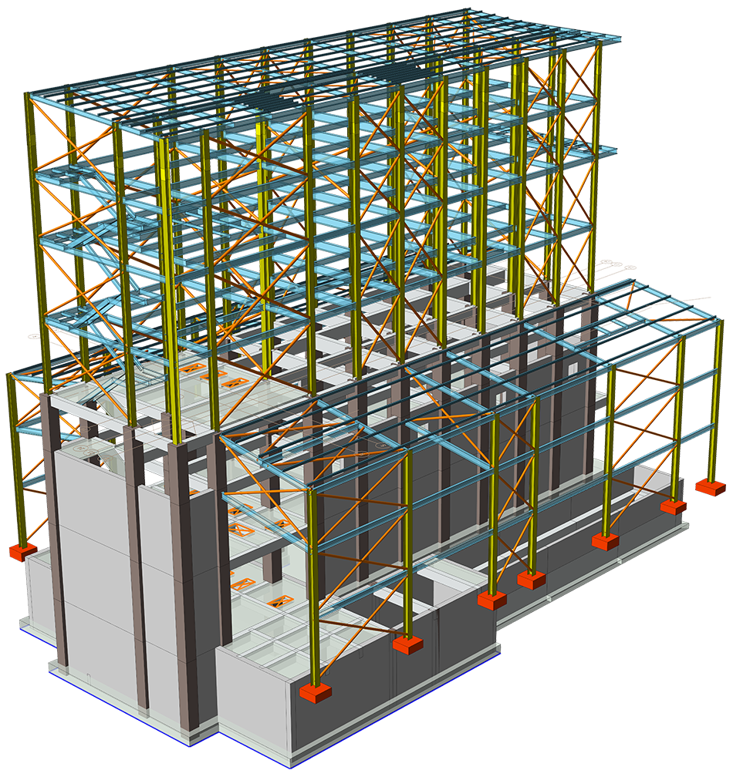
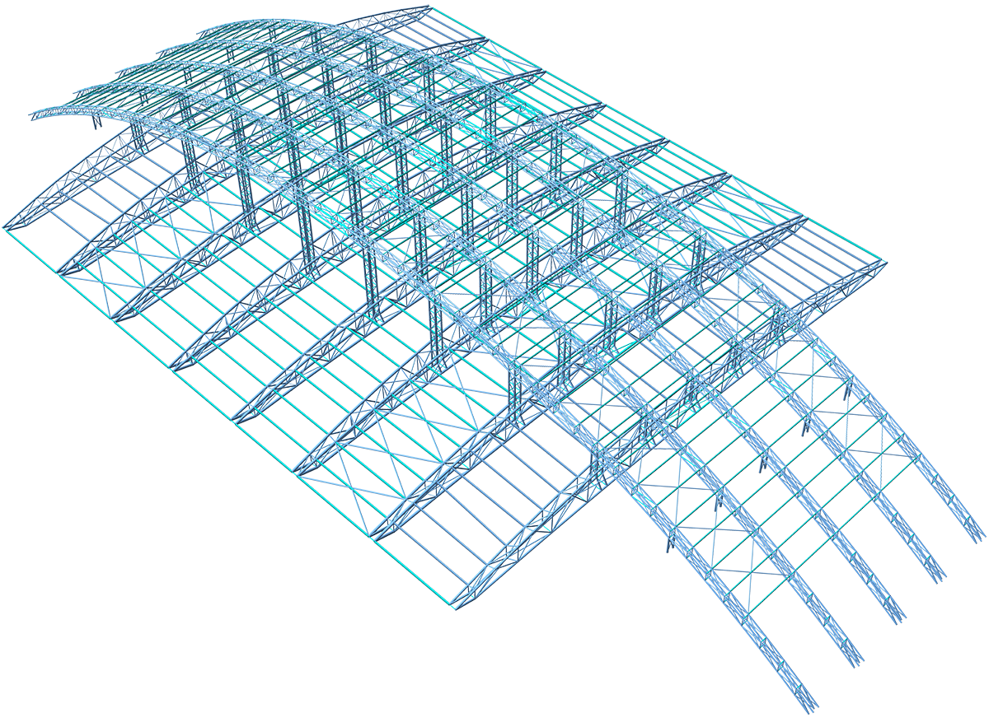
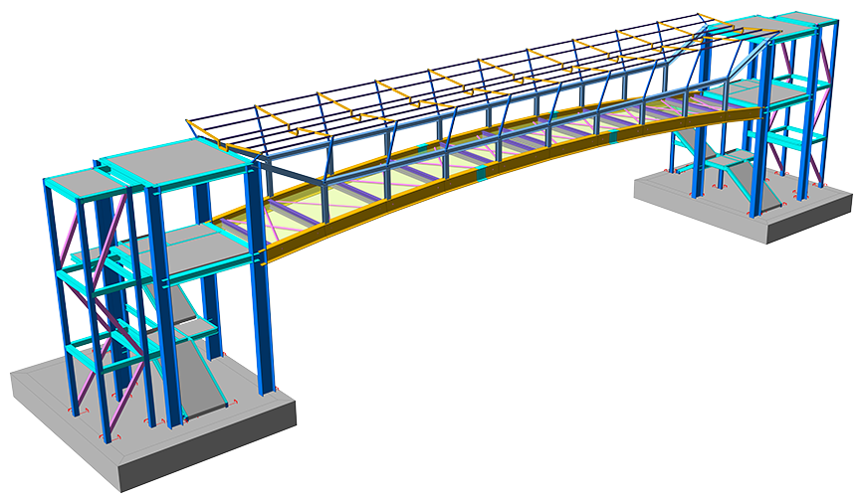
Project Delivery Across the Globe
RC & Steel Industrial Facility
Stadium
Overpass Project
Notes:
As a summary, you can see that our strength lies in buildings and building like structures. You can pretty much design any type of buildings with ProtaStructure Suite.
Here you can see a variety of other buildings such as stadiums, auditorium, playground roof, hangar building, modelled and designed by our users around the world.

Slide 26
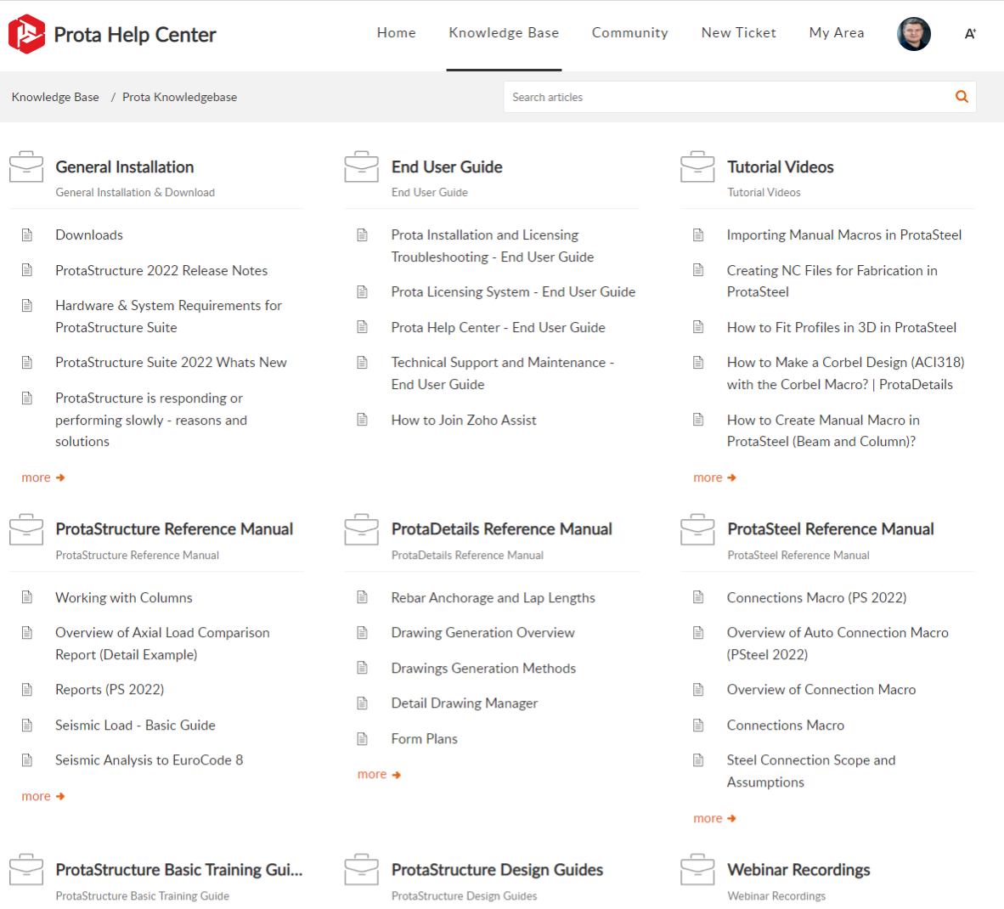
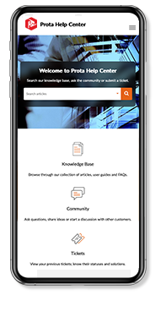
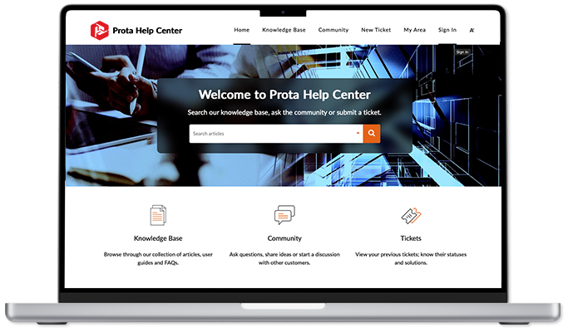
Prota Help Center
– Knowledge Platform & Learning Hub
Notes:
So, what do we offer to our clients that have become customers?
Our licensed users of ProtaStructure Suite do not just benefit from their licenced software technology alone. We gift every new licence owner with 1 year of Maintenance Plan to ensure a smooth onboarding period for newcomers. Hence, within this framework, our customers are given access to our comprehensive and dynamic Prota Help Center where they will be able to;
Browse through our collection of Knowledgebase articles.
Create unlimited Support Tickets to get help from Prota Support Team 24/7.
View previous tickets and follow-up their status.
Ask questions in Community Forums and easily share information with other engineers.
On top of that, customers are able to receive updates and new releases during their maintenance plan. For more details you can reach out to our global sales team separately on this.

Slide 27
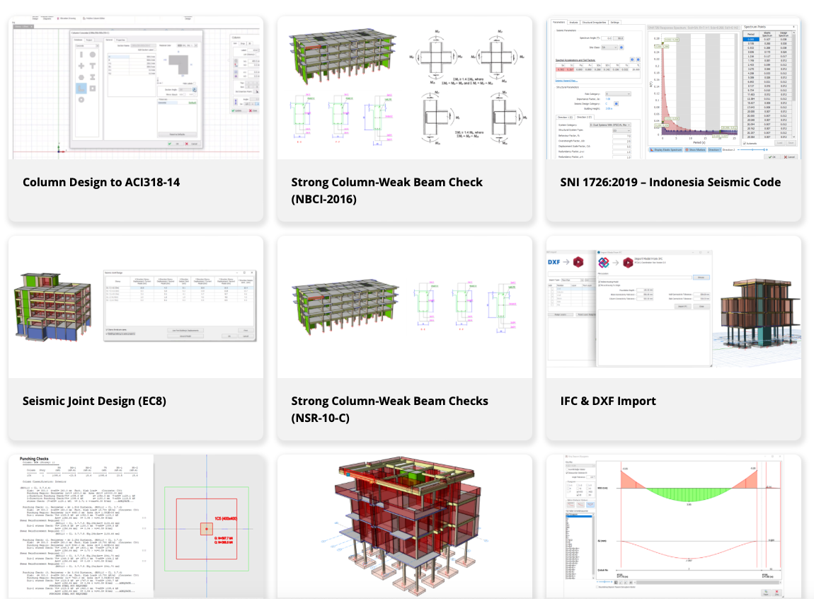
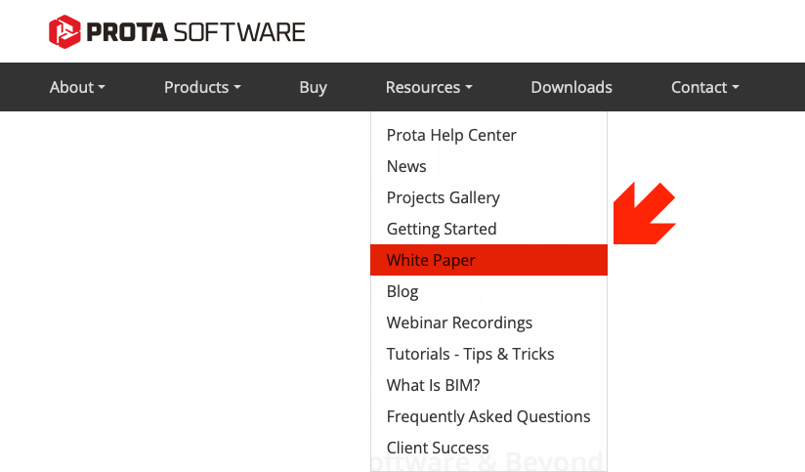
Prota Website
– Whitepapers & Blogs www.protasoftware.com/whitepaper
Notes:
As I have mentioned earlier we have been writing a lot of whitepapers, which are technical documents highlighting newly added features. So feel free to visit protasoftware.com to have a read, I am sure you will be interested to learn about the technical details surrounding these features. Of course, more material is made available to paid users through Prota Help Center, but the free content gives you an idea. We emphasize big importance on transparency and put much effort on being transparent with our users and believe in a healthy two-way communication from our community to ensure ProtaStructure Suite continues to benefit engineers around the world on a daily basis.

Slide 28
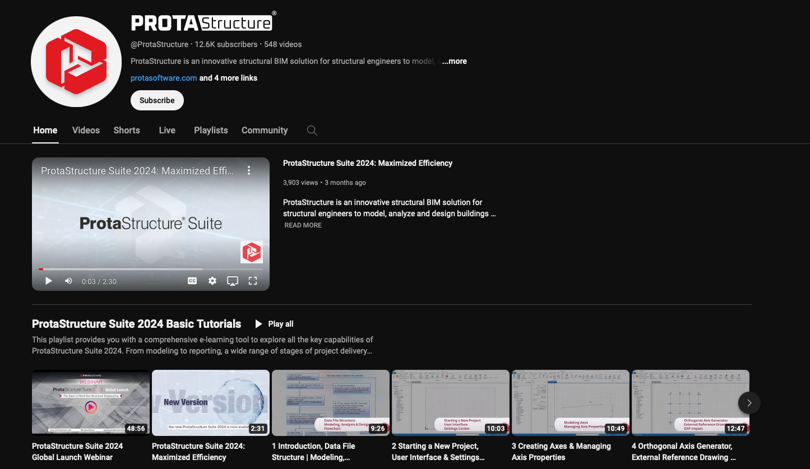
Prota Software Social Media
– Youtube Channel
Notes:
Talking about the free content, please check out our YouTube channel which is called ProtaStructure. Feel free to subscribe and explore our cleanly organised playlists. We periodically introduce new videos, playlists here and webinars that are presented.

Slide 29
Connect and Contact Us
Social Media
Social Media @ Prota Software
Linked In / YouTube / Facebook / Instagram / X (Twitter)
Sales
globalsales@protasoftware.com
Website
www.protasoftware.com
Notes:
We are available on all platforms of social media. Whether you are using Linkedin, Youtube, Facebook, Instagram and Twitter. We are there. You can keep up to date with all Prota related updates there.
If you are interested in our offerings, you can contact us through the contact us page on protasoftware.com or you can e-mail globalsales@protasoftware.com.
We would love to get to know you and hear your feedback!

Slide 30
Let’s See In Action
Let’s See In Action
Let’s See In Action
Let’s See In Action
Let’s See In Action
Notes:
Thank you for bearing with me this long, I know you’re excited to see the software live. I will pause here and let Volkan take over for a demonstration. Volkan feel free to share your screen when you are ready.

